Slide 1
UNIT I – Hour II
FUNDAMENTALS OF SE
Topic: SDLC

Slide 2
Software process, project and product
Process:
Process is a set of sequence steps that have to be followed to create a project.
The main purpose of a process is to improve the quality of the project.
The process serves as a template that can be used throughout the organization for creation of project and to direct the project.

Slide 3
What is a Process?
(Webster) A system of operations in producing something; a series of actions, changes, or functions that achieve an end or a result.
(IEEE) A sequence of steps performed for a given purpose.

Slide 4
What is a Software Process?
A set of activities, methods, practices, and transformations that people use to develop and maintain software and the associated products (e.g., project plans, design documents, code, test cases, and user manuals).
As an organization matures, the software process becomes better defined and more consistently implemented throughout the organization.
Software process maturity is the extent to which a specific process is explicitly defined, managed, measured and controlled effectively.

Slide 5
Project
A project is “a temporary endeavor undertaken to create a unique product, service, or result.” Operations, on the other hand, is work done in organizations to sustain the business.
Projects are different from operations in that they end when their objectives have been reached or the project has been terminated.
Projects can be large or small and involve one person or thousands of people.
They can be done in one day or take years to complete.
IT projects involve using hardware, software, and networks to create a product, service, or result.

Slide 6
Examples of IT projects include the following:
A team of students creates a smartphone application and sells it online.
A company develops a driverless car.
A college upgrades its technology infrastructure to provide wireless Internet access across the whole campus as well as online access to all academic and student service information.
A company develops a new system to increase sales force productivity and customer relationship management that will work on various laptops, smartphones, and tablets.
A television network implements a system to allow viewers to vote for contestants and provide other feedback on programs via social media sites.

Slide 7
Project Attributes
Projects come in all shapes and sizes. The following attributes help define a project further:
A project has a unique purpose.
Every project should have a well-defined objective.
A project is temporary.
A project has a definite beginning and end
A project is developed using progressive elaboration.
Projects are often defined broadly when they begin, and as time passes, the specific details of the project become clearer. Therefore, projects should be developed in increments. A project team should develop initial plans and then update them with more detail based on new information

Slide 8
A project requires resources, often from various areas.
  Resources include people, hardware, software, and other assets.
  Many projects cross departmental or other boundaries to achieve their unique purposes.
  For the IT collaboration project, people from IT, marketing, sales, distribution, and other areas of the company would need to work together to develop ideas.
  Once the IT collaboration project team has selected key projects for implementation, there might be some additional requirements to meet the new project objectives. The company might also hire outside consultants to provide input.
  People from other companies—product suppliers and consulting companies—may be added to the team.
  Resources, however, are limited and must be used effectively to meet project and other corporate goals.

Slide 9
A project should have a primary customer or sponsor.
  Most projects have many interested parties or stakeholders, but for a project to succeed someone must take the primary role of sponsor.
  The project sponsor usually provides the direction and funding for the project.
  Executive support is crucial to project success

Slide 10
Project Stakeholders
Stakeholders are the people involved in or affected by project activities, and include the project sponsor, project team, support staff, customers, users, suppliers, and even opponents of the project.
These stakeholders often have very different needs and expectations
A familiar example of a project is building a new house.

Slide 11
An effective project manager is crucial to a project’s success. Project managers work with the project sponsors, team, and the other people involved to achieve project goals.
A project involves uncertainty.
  Because every project is unique, it is sometimes difficult to define its objectives clearly, estimate how long it will take to complete, or determine how much it will cost.
  External factors also cause uncertainty, such as a supplier going out of business or a project team member needing unplanned time off.
  This uncertainty is one of the main reasons project management is so challenging, especially on projects involving new technologies.

Slide 12
Project Constraints
Every project is constrained in different ways, often by its scope, time, and cost goals.
These limitations are sometimes referred in project management as the triple constraint.
Each area—scope, time, and cost—has a target at the beginning of the project.
Managing the triple constraint involves making trade-offs between scope, time, and cost goals for a project.
To create a successful project, a project manager must consider scope, time, and cost and balance these three often-competing goals

Slide 13
Triple Constraints
Scope:
What work will be done as part of the project? What unique product, service, or result does the customer or sponsor expect from the project? How will the market demand be verified?
Time:
How long should it take to complete the project? What is the project’s schedule? How will the team track actual schedule performance? Who can approve changes to the schedule?
Cost:
What should it cost to complete the project? What is the project’s budget? How will costs be tracked? Who can authorize changes to the budget?

Slide 14
Product
In the context of software engineering, product includes any software manufactured based on the customer’s request.
This can be a problem solving software or computer based system.
It can also be said that this is the result of a project.
A product tends to be short-term.
Product is created based on the needs and expectations of the customers.

Slide 15
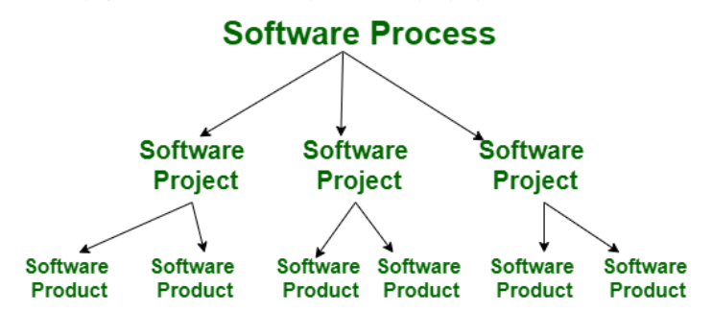

Slide 16
Software Lifecycle Models
A software lifecycle model is a standardised format for
planning
organising, and
running
a new project development.

Slide 17
Hundreds of different kinds of models are known and used.
Many are minor variations on just a small number of basic models. In this section we:
survey the main types of model, and consider how to choose between them.

Slide 18
Planning with Models
SE projects usually live with a fixed financial budget. (An exception is maintainance?)
Additionally, time-to-market places a strong time constraint.
There will be other project constraints such as staffing.

Slide 19
designers
programmers
managers
money
staff
Project constraints
Computing
resources
time
Examples of Project Constraints

Slide 20
Project planning is the art of scheduling the necessary activities, in the perspective of time, cost and staff in order to have optimized result.
project risk [low]
profit [high]
customer satisfaction [high]
worker satisfaction [high]
long-term company goals [satisfication]

Slide 21
A project plan contains much information, but to describe few:
resources needed
(people, money, equipment, etc)
dependency & timing of work
(flow graph, work packages)
rate of delivery (reports, code, etc)
It is impossible to measure rate of progress.

Slide 22
In addition to project members, the following
may need access to parts of the project plan:
Management
Customers
Subcontractors
Suppliers
Investors
Banks

Slide 23
Project Visibility
Unlike other engineers (e.g. civil, electronic, chemical … etc.) software engineers do not produce anything physical.
It is inherently difficult to monitor a SE project due to lack of visibility.

Slide 24
This means that SE projects must produce additional deliverables (artifacts) which are visible, such as:
Design documents/ prototypes
Reports
Project/status meetings
Client surveys (e.g. satisfaction level)

Slide 25
What is a Lifecycle Model?
Definition.
  A (software/system) lifecycle model is a description of the sequence of activities carried out in an SE project development, and the relative order of these activities.

Slide 26
It provides a fixed generic framework that can be tailored to a specific project.
Project specific parameters will include:
Size, (person-years)
Budget,
Duration.
project plan =
lifecycle model + project parameters

Slide 27
There are hundreds of different lifecycle models to choose , out of that few popular models are listed below:
waterfall
V Shaped
code-and-fix
spiral
rapid prototyping
unified process (UP)
agile methods, extreme programming (XP)
COTS …
but many are minor variations on a smaller number of basic models.

Slide 28
By changing the lifecycle model, we can improve and/or tradeoff:
Development speed (time to reach market)
Product quality
Project visibility
Customer relations
Administrative overhead
Risk exposure, etc.

Slide 29
Normally, a lifecycle model covers the entire lifetime of a product.
From birth of a commercial idea to final re-installation of last release
i.e. The three main phases:
design
build
maintain

Slide 30
Note that we can sometimes combine lifecycle models,
e.g. waterfall inside evolutionary – onboard shuttle software
We can also change lifecycle model between releases as a product matures,
e.g. rapid prototyping → waterfall

Slide 31
The Waterfall Model
The waterfall model is the classic lifecycle model – it is widely known, understood and (commonly) used.
In some aspects, waterfall is the ”common sense” approach.
Introduced by Royce 1970.

Slide 32
phase
output
User Requirements
User Requirements Document
Software Requirements
Software Requirements
Document
Architecture Design
Architectural Design
Document
”Swimming
upstream”
Detailed design & Coding
Detailed
Design
& Code
The Waterfall
Lifecycle Workflow
Testing
Delivery
Time

Slide 33
Waterfall Strengths
Easy to understand, easy to use
Provides structure to inexperienced staff
Milestones are well understood
Sets requirements stability
Good for management control (plan, staff, track)

Slide 34
Waterfall Deficiencies
All requirements must be known upfront
Deliverables created for each phase are considered frozen – inhibits flexibility
Can give a false impression of progress
Does not reflect problem-solving nature of software development
Integration is one big bang at the end
Little opportunity for customer to preview the system (until it may be too late)

Slide 35
When to use the Waterfall Model
Requirements are very well known
Product definition is stable
Technology is understood
New version of an existing product
Porting an existing product to a new platform.
Works well when quality of the project is more important than cost or schedule

Slide 36
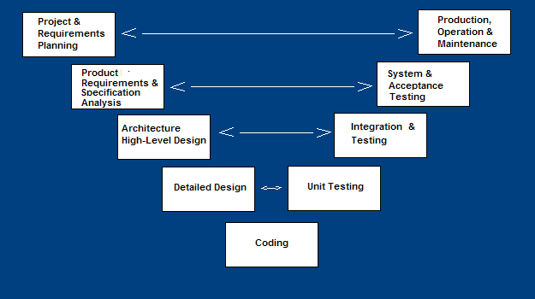
V-Shaped SDLC Model
A variant of the Waterfall that emphasizes the verification and validation of the product.
Testing of the product is planned in parallel with a corresponding phase of development

Slide 37
V-Shaped Steps
Project and Requirements Planning – allocate resources
Product Requirements and Specification Analysis – complete specification of the software system
Architecture or High-Level Design – defines how software functions fulfill the design
Detailed Design – develop algorithms for each architectural component
Production, operation and maintenance – provide for enhancement and corrections
System and acceptance testing – check the entire software system in its environment
Integration and Testing – check that modules interconnect correctly
Unit testing – check that each module acts as expected
Coding – transform algorithms into software

Slide 38
V-Shaped Strengths
Emphasize planning for verification and validation of the product in early stages of product development
Each deliverable must be testable
Project management can track progress by milestones
Easy to use

Slide 39
V-Shaped Weaknesses
Does not easy to handle concurrent events
Does not handle iterations or phases
Does not easy to handle dynamic changes in requirements
Does not contain risk analysis activities

Slide 40
When to use the V-Shaped Model
Excellent choice for systems requiring high reliability – hospital patient control applications.
All requirements are known up-front.
Solution and technology are known to handle change in requirements beyond analysis phase.

Slide 41
Code-and-Fix
This model starts with an informal general product idea and just develops code until a product is ”ready” (or money or time runsout).
Work is in random order.
Corresponds with no plan! (Hacking!).

Slide 42
Advantages
No administrative overhead.
Signs of progress (code) early.
Low expertise.
Anyone can use it.
Risk reduction (in terms of budget).

Slide 43
Disadvantages
Dangerous!
  No visibility/control
  No resource planning
  No deadlines
  Mistakes hard to detect/correct
Impossible for large projects
If it is a group project then this model will leads to communication breakdown, chaos ..etc

Slide 44
When to use the code-and-fix model
Useful for small projects (“proof of concept” ).
Useful for individual projects for learning a particular concept.
Eg:- mini-project, lab exercise

